Slide 1
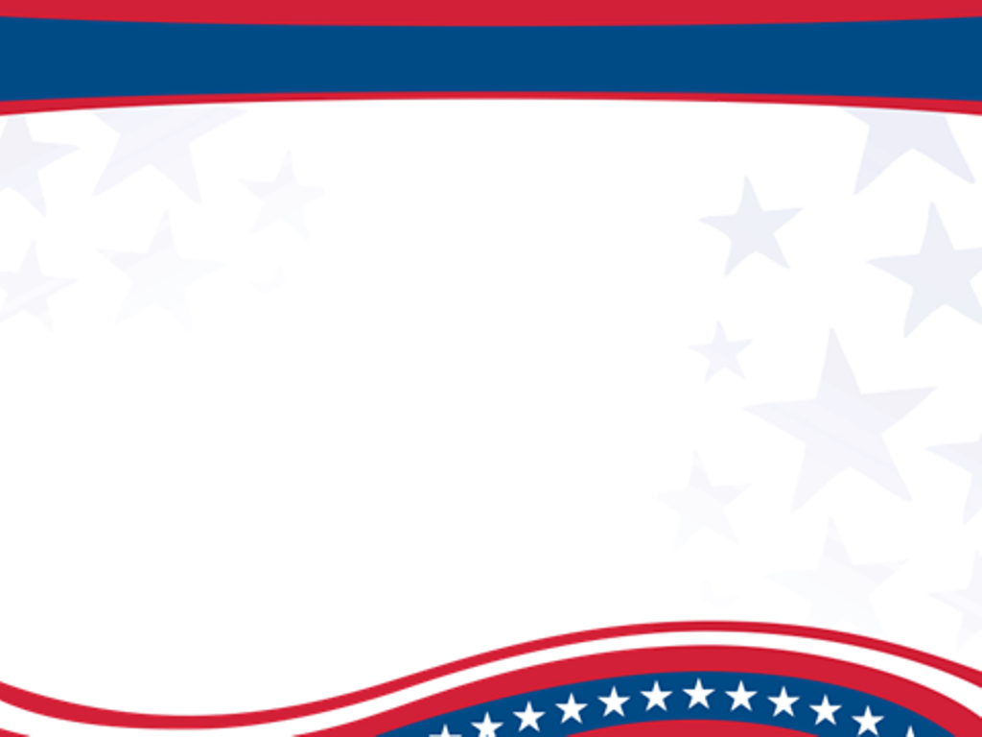
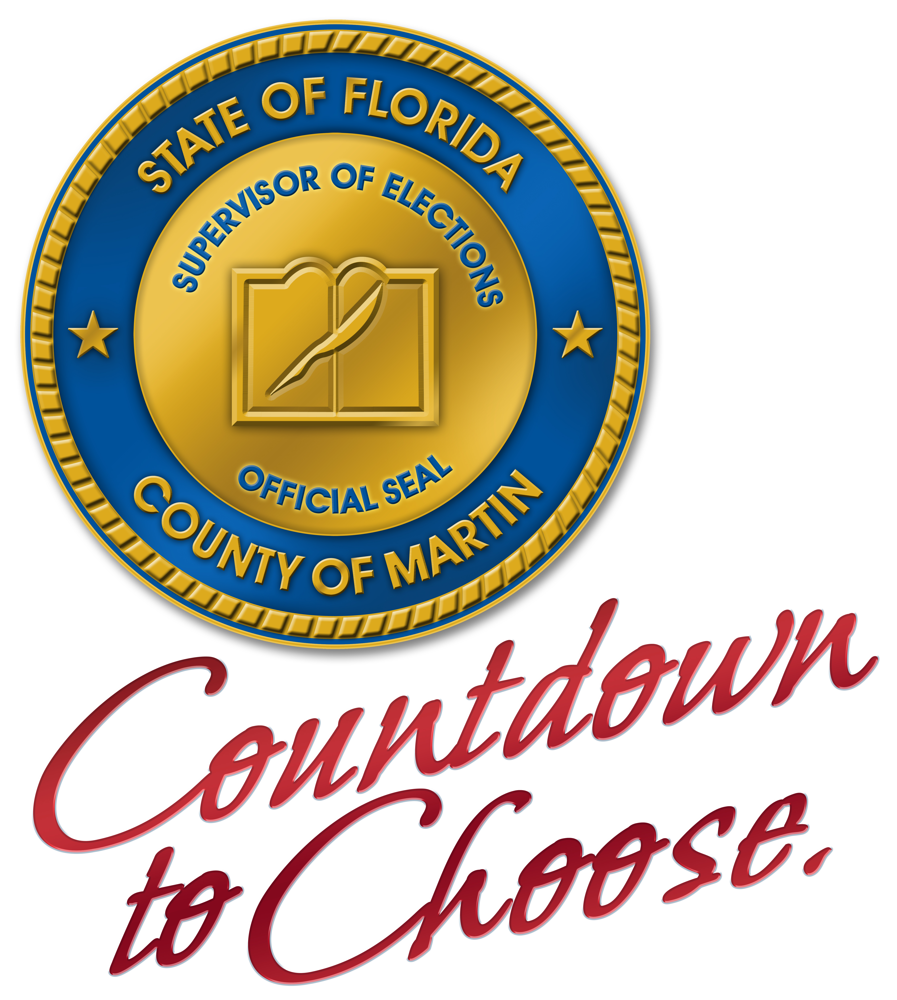
Countdown to Choose. We’re Ready, Are You?

Slide 2
Tax Collector / HSmv
The passage of the National Voting Rights Act of 1995 placed HSMV on the frontline of democracy.

Slide 3
Tax Collector / HSmv
Since 1995, HSMV has registered or updated 9,348,115 voter records
This accounts for 49% of Florida’s voter records

Slide 4
Election Update
2012 Election Ballot
President of the United States
United States Senator
United States Representative
State Attorney
Public Defender
State Senator
State Representative
Clerk of Court
Sheriff
Property Appraiser
Tax Collector
Supervisor of Elections
Superintendent of Schools
County Commission
Circuit Judge
School Board
Special Districts
11 Constitutional Amendments*

Slide 5
Election Update
State of Florida Turnout
2004
Primary 26%
General 74%
2008
Primary 18%
General 75%
2012 (projected)
Primary 25%
General 76%

Slide 6
Florida Primaries
  Not all states are created equal
  Florida is a closed primary state
  Voters can ONLY vote their party in a primary
  Voters who register with No Party Affiliation or with a minor party will only be eligible to vote for Judges, School Board and issues in a primary

Slide 7
2012 Election Dates
Primary Election
August 14, 2012
Books Close – July 16, 2012
General Election
November 6, 2012
Books Close – October 9, 2012

Slide 8
Bookclosing (F.S. 97.055)
Voter registration books close 29 days prior to the election
Continue to register voters and make party changes.
However, they will take affect for subsequent elections.

Slide 9
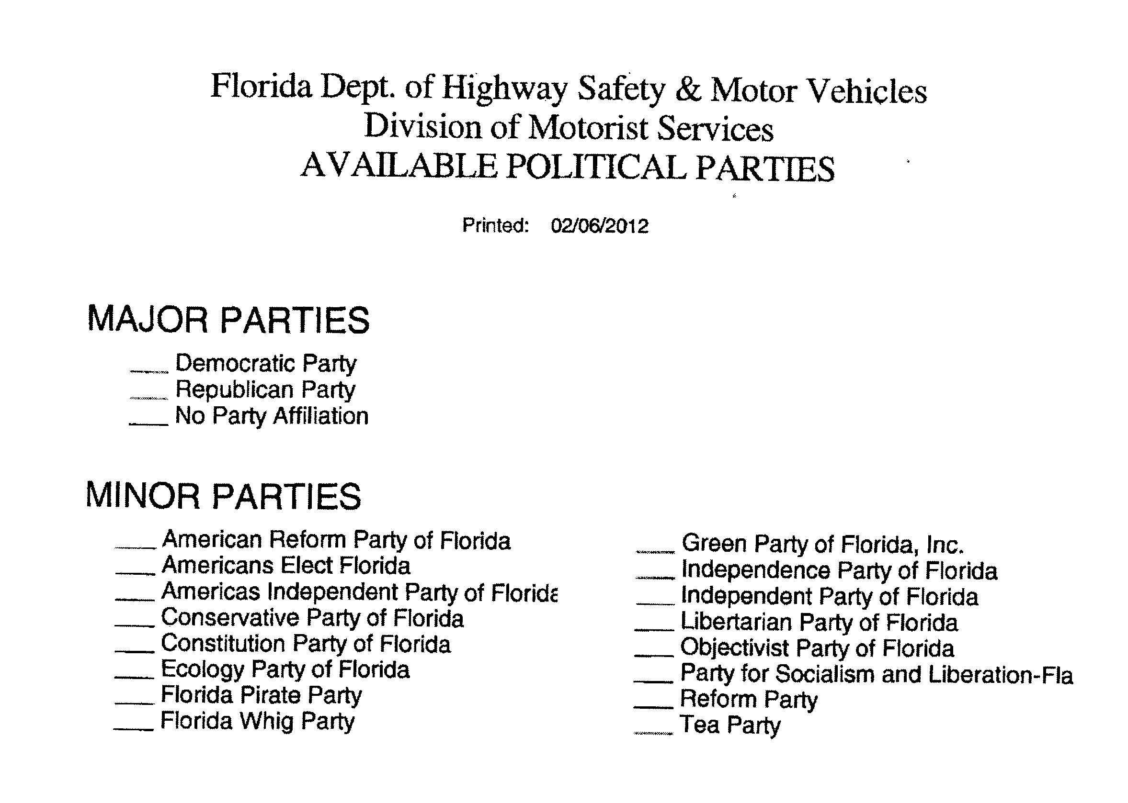
Revision to the Party list within FDLIS
***No Party Affiliation is not a party

Slide 10
Nassau County SOE
Possible script: Would you like me to update your voter registration record at this time to ensure your information is current?
If an examiner needs to go back into an applicant’s record to make a correction, sometimes it will void the voter registration record. This may be a programmatic change or a training issue.
Provide HSMV with a SOE contact card advising if the voter does not receive their voter information card within two weeks they should contact the SOE office.

Slide 11
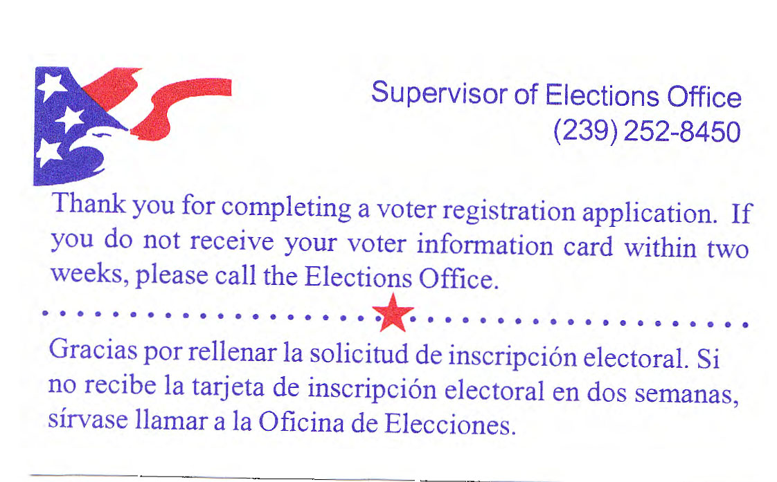
Collier County SOE
The DL Clerks hand one contact card to each registrant.
It would be helpful for the DMVs to further promote address updates, party changes, etc.
DMV staff should encourage the voters to review their voter information for accuracy before leaving the DMV.
If an operator needs to go back into an applicant’s record to make a correction, sometimes it will void the voter registration record. If possible, amend the software to include a warning which would alert the operator of the cancellation.

Slide 12
Pasco County SOE
The following are always sources of confusion for the voters and DMV employees:
    Closed primaries
    The difference between claiming no party affiliation/being affiliated with the Independent party/and claiming oneself an “Independent”
Any script conveyed between DMV employees and prospective voters should stress the importance of verifying their information as it has been entered by the DMV, particularly party choice.

Slide 13
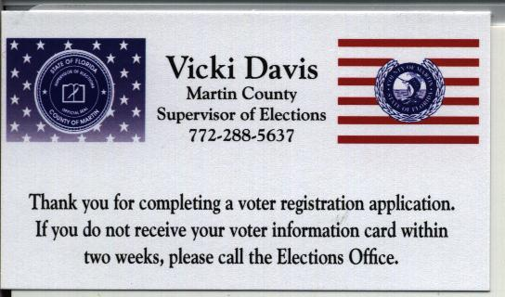
Martin County SOE
Provide the voter with a card containing the contact information for the Supervisor of Elections.
Encourage the voter to retain their receipt until they receive their voter information card. If for some reason the record is lost in transmittal, the Supervisor of Elections can use the receipt date for the voter’s registration date.

Slide 14
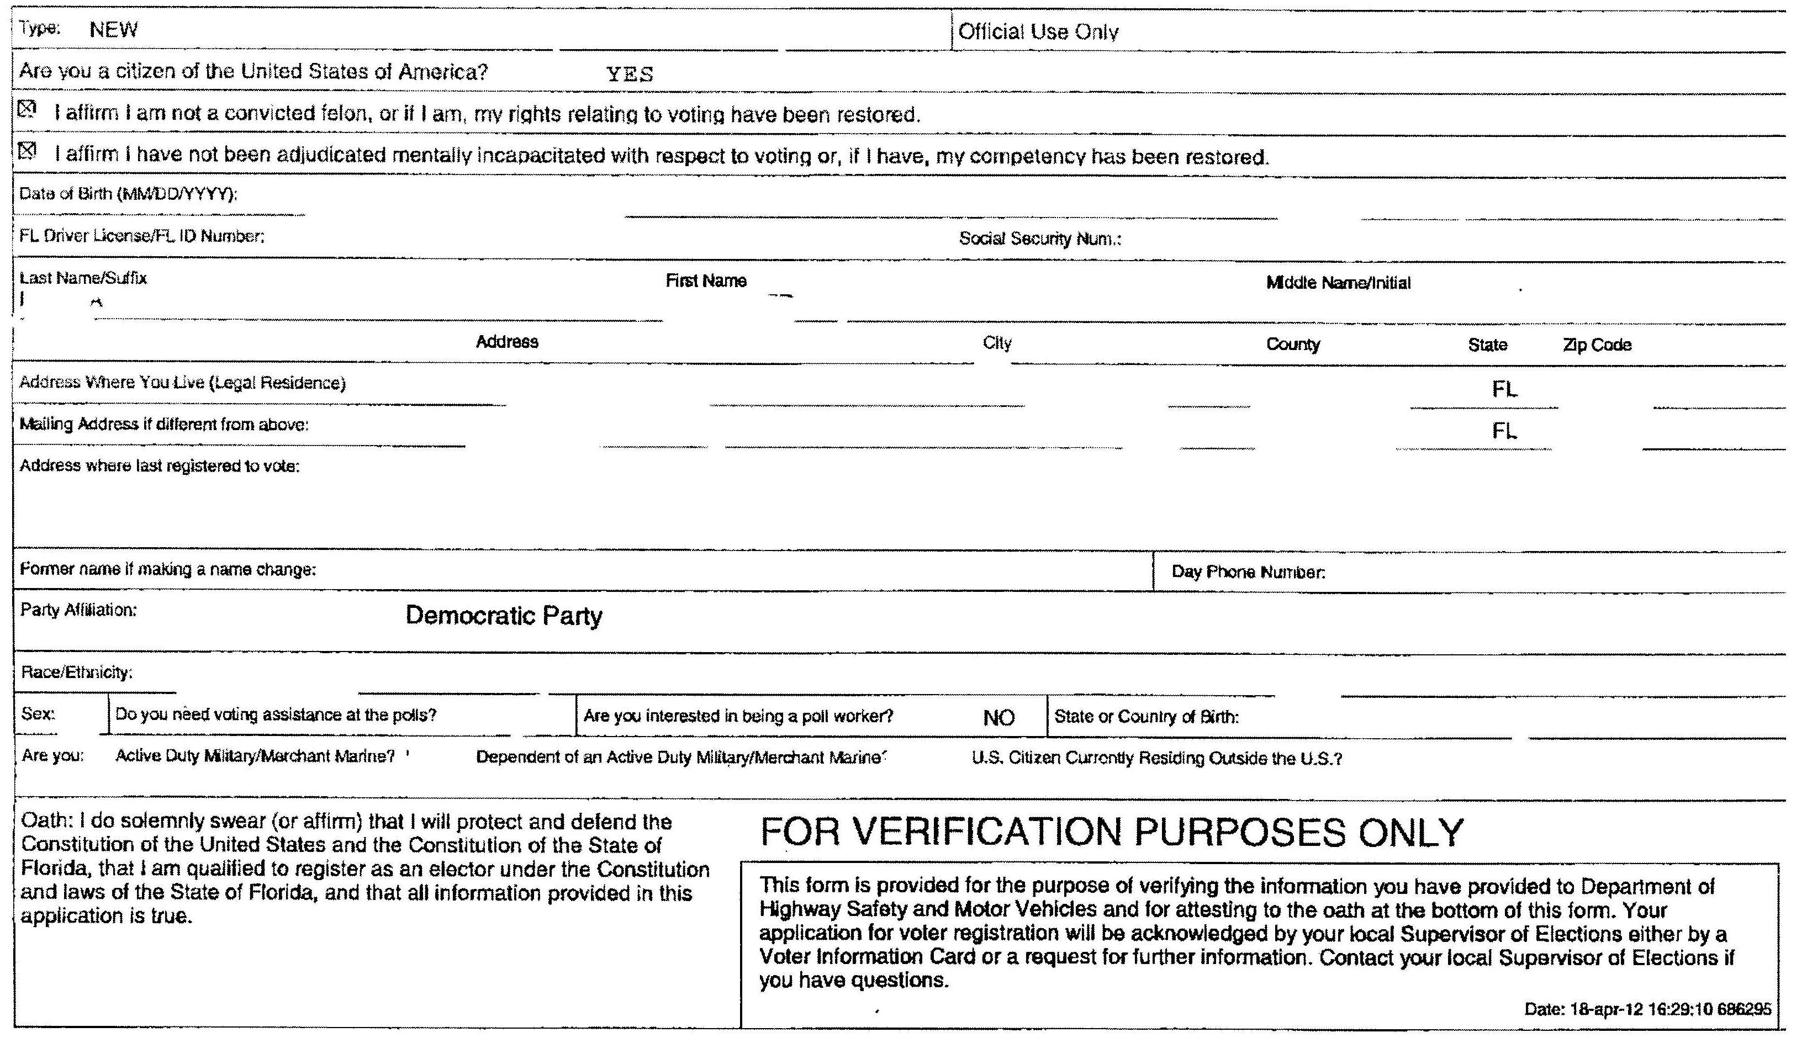
Martin County

Slide 15
2012 Election Goal
Provide Voters Opportunities to
Check and Update their Voter Status:
  Has your address changed?
  Would you like to change your political party?
  Has your name changed?
  Do you need to update your signature?

Slide 16
Thank You For Your Partnership and For Being The Gatekeepers Of Democracy

Slide 17
Questions?

